Slide 1
Qualified Independent Contractor Demonstration Available for Part A East
Scenarios

Slide 2
Scenarios Background
The reference material provided within this presentation has been taken directly from reconsiderations submitted to the Qualified Independent Contractor (QIC), C2C, in association with those providers participating in the Part A East QIC Telephone Discussion Demonstration
The purpose of this material is to demonstrate the necessity of complete and thorough documentation when submitting an appeal. It is not a guide or a template for how documentation should look, read, or be formatted.
Novitas Solutions encourages providers to bill using the most complete, comprehensive, and specific CPT/HCPCS code to describe the services rendered. The code billed must also match the documentation in the patient’s records.

Slide 3
Acronym List
Acronym | Definition
BMM | Bone Mass Measurement
CPT | Current Procedural Terminology
ICD-10 | International Classification of Diseases, Tenth Revision
LCD | Local Coverage Determination
MAC | Medicare Administrative Contractor
NCD | National Coverage Determination
PHPT | Primary Hyperparathyroidism
QIC | Qualified Independent Contractor

Slide 4
Ultrasound Scan of the Veins of One Arm or Leg or Limited Including Assessment of Compression and Functional Maneuvers (93971)
Scenario One
Current Procedural Terminology (CPT) only copyright 2018 American Medical Association. All rights reserved.

Slide 5
Scenario 1
Payment was not allowed by the MAC at the redetermination level because the documentation did not support the services as reasonable and necessary as outlined within the LCD guidelines and associated billing article:
L35451
A52993
Provider reported diagnosis codes:
M17.12 - Unilateral Primary Osteoarthritis, Left Knee
M25.562 - Pain in Left Knee
Provider received an unfavorable decision and appealed to the QIC
Reconsideration was selected to participate in the telephone discussion demo
Current Procedural Terminology (CPT) only copyright 2018 American Medical Association. All rights reserved.

Slide 6
Scenario 1 continued
During the telephone call, the participant was educated based on the requirements of the LCD (L35451)
Participant provided verbal testimony stating that per LCD L35451, the diagnosis of swelling and edema of the extremities are covered indications:
Records indicated that the beneficiary was seen in the urgent care clinic with complaints of lower leg heaviness
Beneficiary reported:
Symptoms were worsening
Her left lower leg would swell at times
Physician documented that a doppler was ordered to rule out a blood clot

Slide 7
How to Avoid Claim Denials and Appeals
Bill it right the first time:
Original claim submission should have had covered diagnosis code reported per LCD:
Additional documentation provided to the QIC during the telephone discussion supported LCD coverage guidelines

Slide 8
Radiological Supervision and Interpretation X-ray of Abdominal Aorta and Both Leg Arteries (75630)
Scenario Two
Current Procedural Terminology (CPT) only copyright 2018 American Medical Association. All rights reserved.

Slide 9
Scenario 2
Payment was not allowed by the MAC at the redetermination level because the documentation did not support the services as reasonable and necessary as outlined within the LCD guidelines and associated billing article:
L35092
A56682
Diagnosis codes billed:
I70.242 - Atherosclerosis of native arteries of left leg with ulceration of calf
I47.1 - Supraventricular Tachycardia
Provider received an unfavorable decision and appealed to the QIC
Reconsideration was selected to participate in the telephone discussion demo
Current Procedural Terminology (CPT) only copyright 2018 American Medical Association. All rights reserved.

Slide 10
Scenario 2 continued
During the telephone call, the participant was educated based on the requirements of LCD (L35092)
Participant provided verbal testimony
The participant stated that she would be submitting additional documentation to support the beneficiary had:
Intermittent claudication-atherosclerosis of the left native coronary artery
Diagnosis of peripheral vascular disease
Non-healing wound

Slide 11
Scenario 2 continued (2)
The medical records evidence indicate the beneficiary underwent an abdominal X-ray for atherosclerosis of native arteries of left leg with ulceration of calf.
History and physical states the beneficiary presented for evaluation of a non-healing wound on her left calf following a scratch from her puppy four months prior. The physician documents that she has symptoms of rest pain and has symptoms of claudication.
Physical examination also shows the beneficiary had absent bilateral dorsalis pedis and posterior tibial pulses.
Physician recommends an arteriogram with possible angioplasty and stenting due to her non-healing wound and symptoms consistent with rest pain and markedly abnormal noninvasive studies.

Slide 12
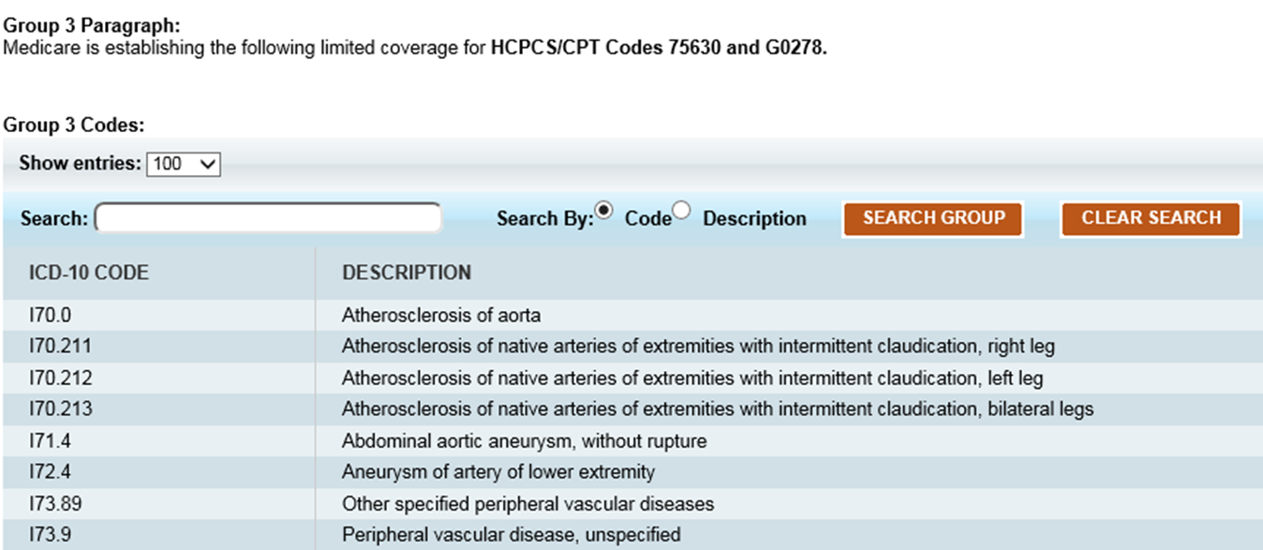
Scenario 2 continued (3)
Bill it right the first time:
Original claim submission should have had covered diagnosis code reported per LCD:
Additional documentation provided to the QIC during the telephone discussion supported LCD coverage guidelines
Current Procedural Terminology (CPT) only copyright 2018 American Medical Association. All rights reserved.

Slide 13
Bone Density Measurement Using Dedicated X-Ray Machine (77080)
Scenario Three
Current Procedural Terminology (CPT) only copyright 2018 American Medical Association. All rights reserved.

Slide 14
Scenario 3
Payment was not allowed by the MAC at the redetermination level because the documentation did not support the services as reasonable and necessary as outlined within the NCD guidelines:
NCD 150.3
Medical record did not include documentation supporting the need for more frequent bone density measurement testing
Provider reported diagnosis code:
E21.3 - Hyperparathyroidism, Unspecified
Provider received an unfavorable decision and appealed to the QIC
Reconsideration was selected to participate in the telephone discussion demo
Current Procedural Terminology (CPT) only copyright 2018 American Medical Association. All rights reserved.

Slide 15
Scenario 3 continued
Prior to the call, the QIC requested the following documentation: a current history or physician’s notes to substantiate that the BMM performed was rendered according to Medicare guidelines.
The QIC received the following documents:
Physician office visit notes
Diagnostic testing results

Slide 16
Scenario 3 continued (2)
Participants were educated based on the requirements of the NCD 150.3:
Participants provided verbal testimony stating that the PHPT level controls calcium levels and affects bone density and that screening for osteoporosis due to PHPT levels is customary and would meet medical necessity for screening for osteoporosis according to the NCD
Participants added that patient had:
Forearm osteopenia
Even though her calcium was increased, her vitamin D and calcium levels were low

Slide 17
Scenario 3 continued (3)
Bill it right the first time:
Original claim submission should have had covered diagnosis code reported per NCD to show medical necessity for more frequent BMM:
Additional documentation provided to the QIC during the telephone discussion supported NCD coverage guidelines
When medically necessary, Medicare may pay for more frequent BMMs than every 2 years (CPT 77080 and 77085)
Examples include, but are not limited to:
Monitoring beneficiaries on long-term glucocorticoid (steroid) therapy of more than 3 months
Confirming baseline BMMs to permit monitoring of beneficiaries in the future
Reporting an allowable ICD-10 diagnosis:
E24.4, E24.9, E24.2, E24.3, E24.8, E24.0, M81.0, M81.8, M81.6, M89.9, M94.9, M85.811/812, M85.821/822, M85.831/832, M85.841/842, M85.851/852, M85.861/862, M85.871/872, M85.88/89, Z79.3, Z79.51, Z79.52, Z79.83
M85.832 - Other Disorder of Bone Density and Structure, Left Forearm
Bone Mass Measurements (BMM) Denials
Current Procedural Terminology (CPT) only copyright 2018 American Medical Association. All rights reserved.

